Slide 1

The Gospel of Mark:
The NeverEnding Story Chapter 14
ELCA Book of Faith Initiative
National Youth Gathering 2015
images by Janelle Thompson amadcatstudio@me.com

Slide 2
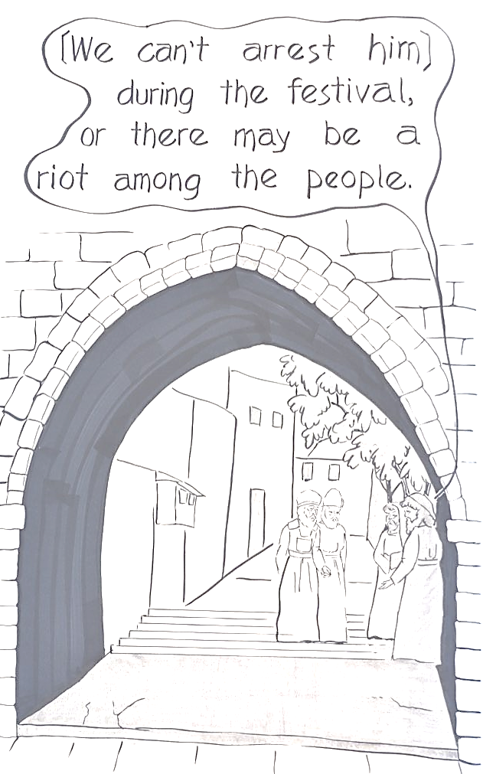

Slide 3
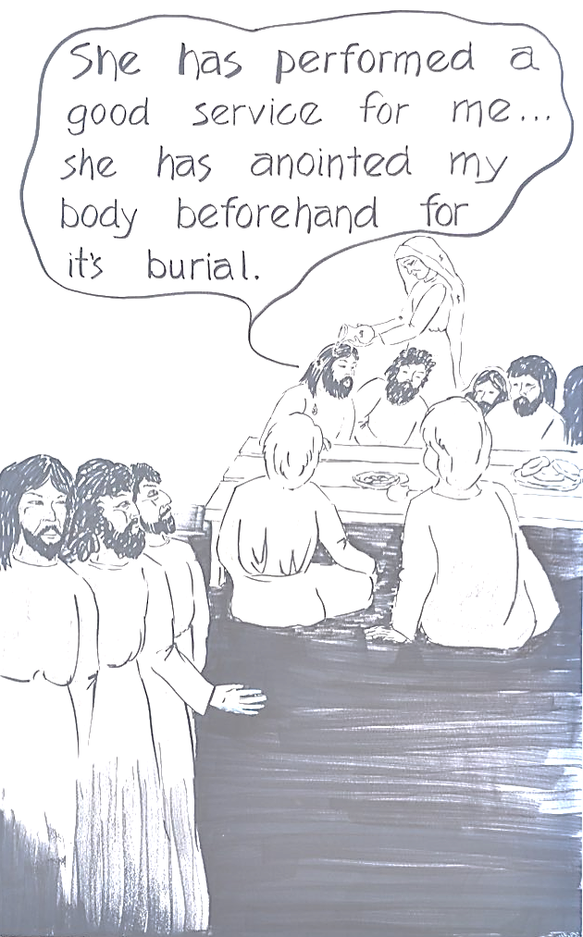

Slide 4
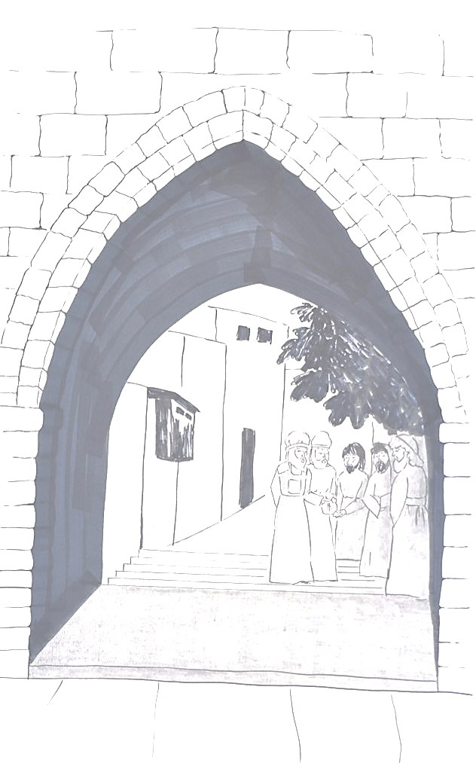

Slide 5
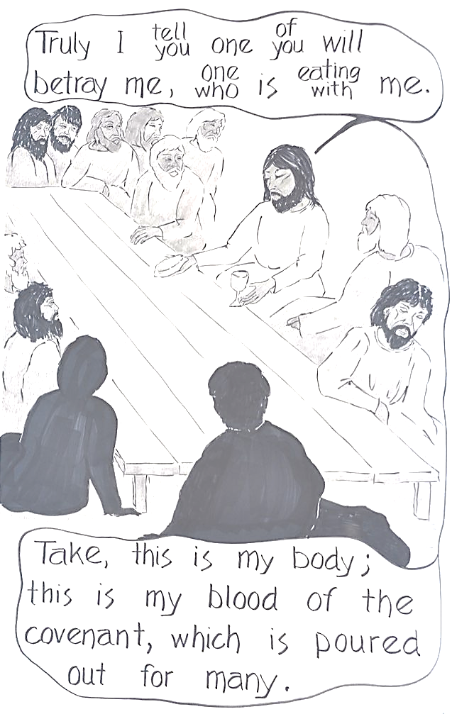

Slide 6
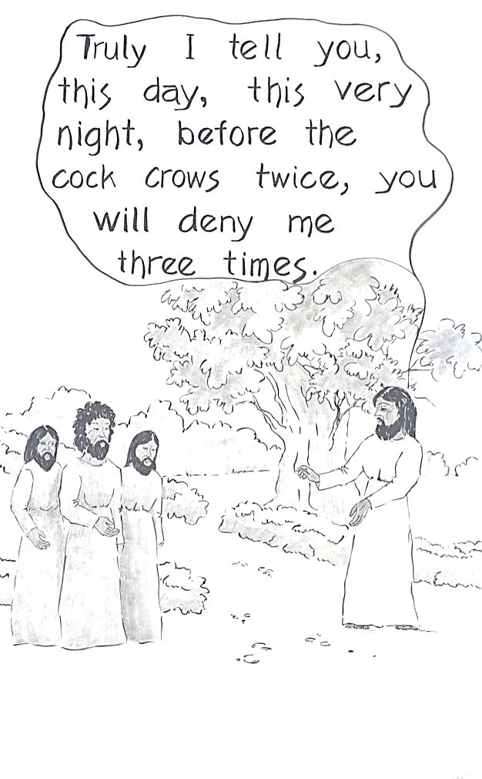

Slide 7
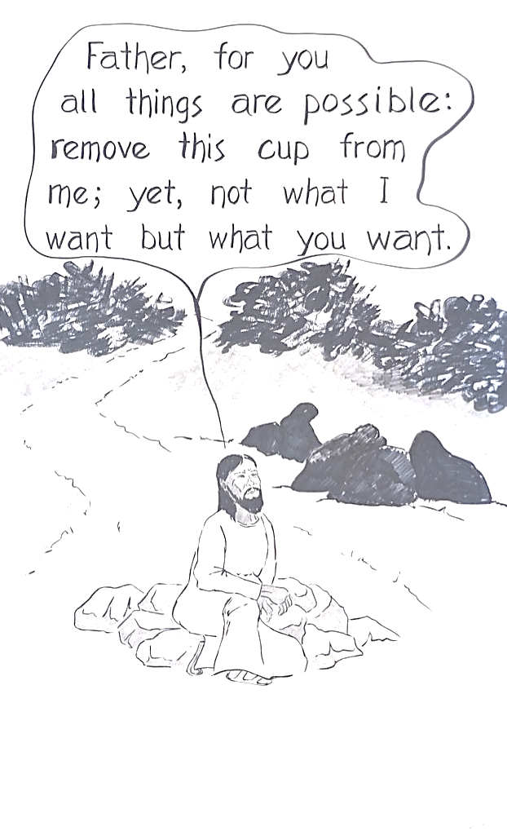

Slide 8
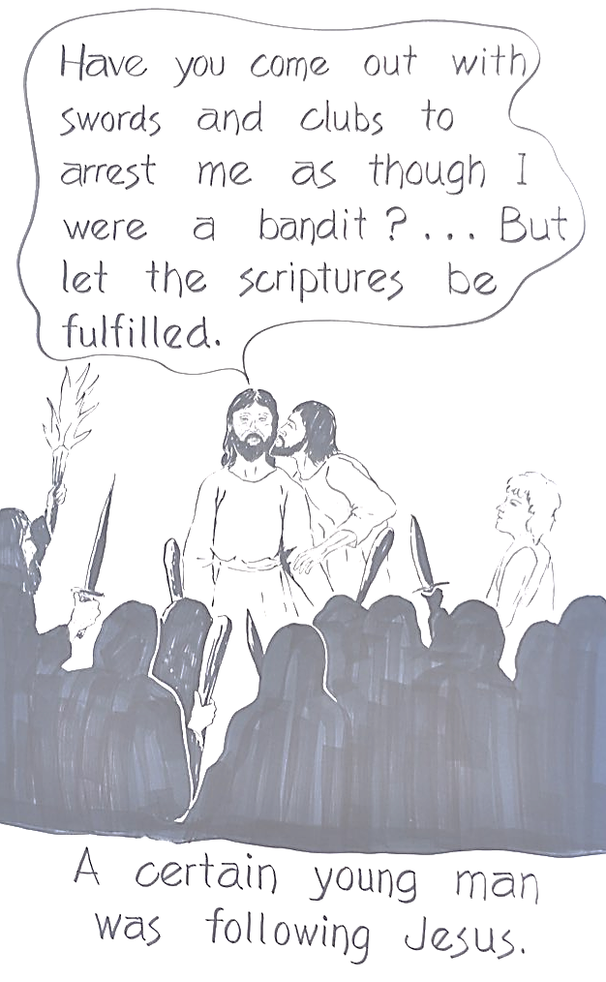

Slide 9
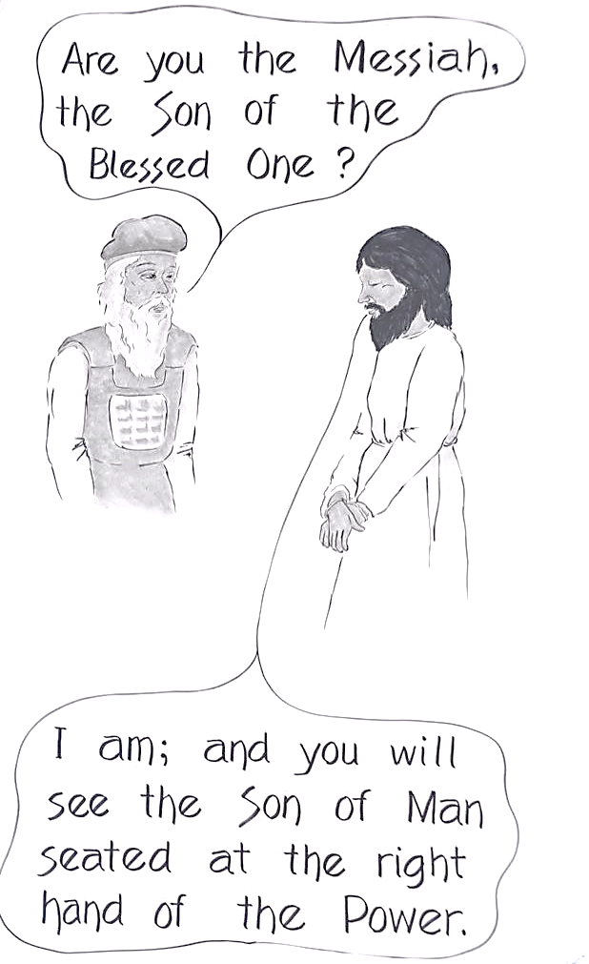

Slide 10
