Slide 1

The Gospel of Mark:
The NeverEnding Story Chapter 5
ELCA Book of Faith Initiative
National Youth Gathering 2015
images by Janelle Thompson amadcatstudio@me.com

Slide 2
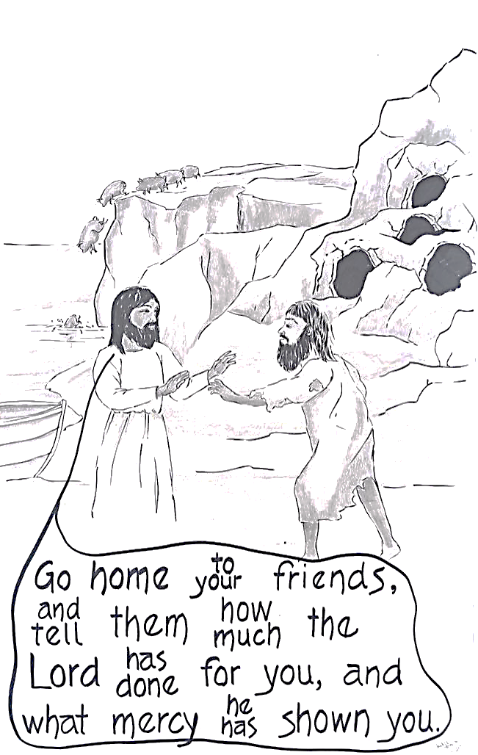

Slide 3
